Slide 1
Emerging Pandemic Threats - PREVENT
AED, Global Viral Forecasting Initiative
& Local partners
Notes:
AED’s primary technical partner in PREVENT is the Global Viral Forecasting Initiative, Incorporated (GVFInc) , governments, and local partners will be added as programs are developed.

Slide 2
Goal: To prevent the emergence and spread of zoonotic diseases, building on USAID’s H5N1 avian influenza efforts.
POLICY
COMMUNITY
INDIVIDUAL
PREVENT applies a social and behavior change approach to develop and introduce interventions for improved practices at multiple levels
Notes:
PREVENT project has the goal of preventing the emergence and spread of zoonotic diseases, building on USAID’s H5N1 avian influenza efforts. PREVENT’s ultimate aim is to develop interventions that reduce transmission of EPT viruses from animals to humans.
Recognizing that behaviors are at the center of human dynamics, PREVENT applies a social and behavior change communication approach to develop and introduce interventions to prevent the emergence and spread of zoonotic diseases.

Slide 3
Drivers of Emerging Infectious Disease
Wildlife
Human
Domestic
Animals
Notes:
The emergence of infectious diseases, and their spread and impact, relate to how pathogens interact with a complex of
social, technological, and environmental processes.
PREVENT seeks to integrate social science, natural science and local knowledge perspectives in a ‘pathways
approach’ to understand their drivers, implications and how they might be addressed in ways that may be more effective,
sustainable and socially just.

Slide 4
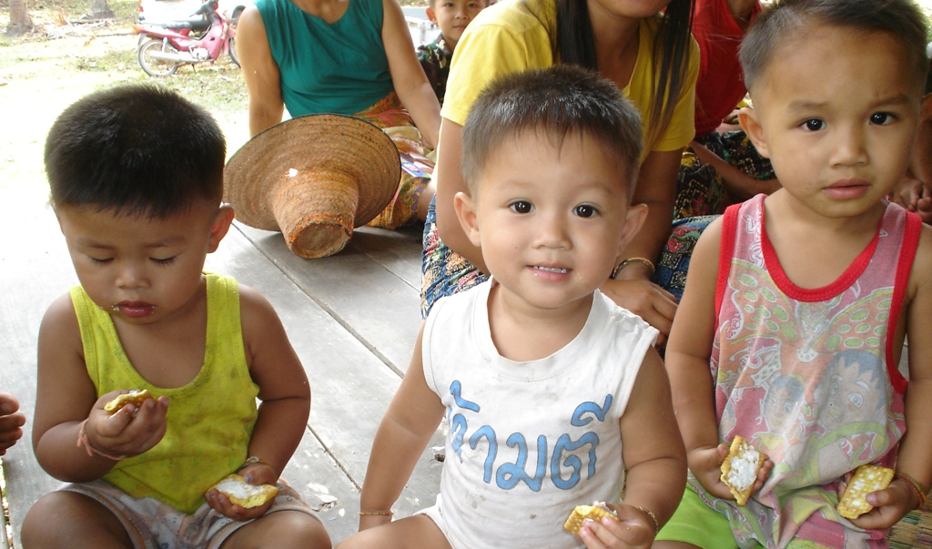
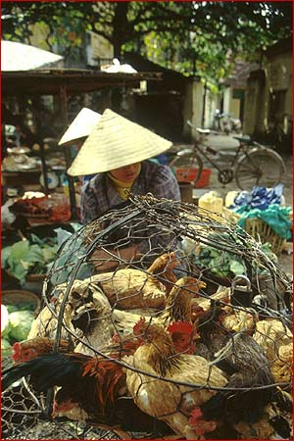
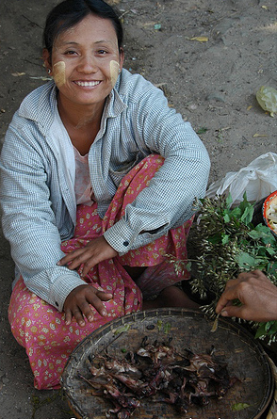
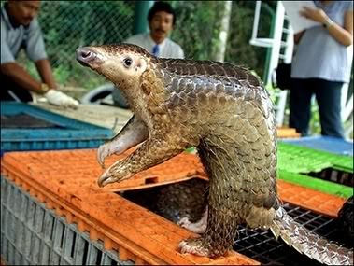
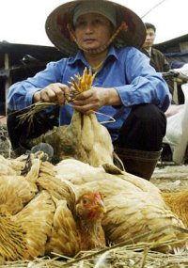
One Health: Many Behaviors
Notes:
PREVENT operates alongside the One Health concept that expands interdisciplinary collaborations, synergy and communications in all aspects of health care for humans, animals and the environment.
PREVENT will build on lessons learned in implementing a multi-sectoral national avian and human influenza strategy to develop interventions to reduce the likelihood of EPT transmission, while addressing Government of Lao PDRs goals of food security, conservation and poverty alleviation.

Slide 5
Behavior Change Communication
Basic approach
Theories | Definition
Health Education | Providing information
Information, education, communication (IEC) | Focused on the “channels” of communication (mass media)
Social marketing | Audience segmentation, motivation
Risk Communication | Informed recipient making better choices about threats to health and safety
Behavior change communication | Focused on theories of individual change
Social and Behavior Change Communication | Recognition of the social aspects of change---norms and networks
BCC motivates people, organizations and systems to adopt practices that sustain safe and health behaviors and lifestyles
Notes:
The basic approach of PREVENT is behavior change communication – that applies theories of individual change.

Slide 6
Factors for Emergence of Zoonotic Diseases
Focus
Prevalence and Dynamics of Disease in Animals
Frequency and Dynamics of Animal -Human Contact
Human - Human Contact
Notes:
Changes in human demographics, behaviors, and land use, among other factors, contribute to the emergence of new diseases by bringing people into closer and more frequent contact with pathogens from animals and plants.
PREVENT seeks to establish evidence base for specific social and behavioral factors -- evolving on the frequency and dynamics of animal and human contact that places people at risk of emerging pandemic threats.

Slide 7
Illustrative Drivers of Emergence and Amplification
PREVENT focus
Family & community interactions
Population density
Population mobility
Individual & community
level
Hunting
Domestic animal production
Primary transmission (e.g., emergence)
PHASE
Early secondary transmission
Amplification to pandemic
System & Infrastructure level
Roads, transport
Housing construction
“Wet” market layout and policies
Health care centers
Globalization of trade
Commercial food production
Notes:
We can debate where things fall in this slide, but our interest is focusing on changing/modifying those behaviors and practices that have the greatest impact on disease emergence.
Increased population in/near wild areas/forests
Increased need for bush meat protein or income, cultural practices/beliefs
House construction
Food storage
Displacement of wildlife
Domestic animal husbandry near wild animals
Contaminated food
Artisanal mining, caving

Slide 8
PREVENT Vision
Clearer evidence base for specific social and behavioral factors that affect risk of emerging pandemic threats (EPT)
Both “risky” and “protective” individual practices
Policies and organizational choices that create contexts that enhance or decrease risks
Globally shared framework for prevention and mitigation of EPT
Tested strategies for preventing EPT
Notes:
PREVENT’s vision is to achieve:
1. Clearer evidence base for specific social and behavioral factors that affect risk of emerging pandemic threats (EPT)
Both “risky” and “protective” individual practices
Policies and organizational choices that create contexts that enhance or decrease risks
2. Globally shared framework for prevention and mitigation of EPT
3. Tested strategies for preventing EPT

Slide 9
PREVENT Objectives
Objective 1: Develop a strategic framework for risk reduction
Identify specific pathways
Type of intervention
Approaches
Results
Regulatory
Set limits (policies) & create incentives
Managerial
Improve processes
Behavioral
Change habits & sustain better habits
Social
Change norms, increase support
Reduced human exposure; reduced transmission
Notes:
Throughout the life of the project, PREVENT will develop and refine a strategic framework for risk reduction to guide decisions about interventions for reducing the probability of transmission of EPT viruses from wild animals to humans. The initial draft will be developed in consultation with a range of experts; but it will be updated periodically as experience from the field is accrued. The risk reduction framework will help to inform and guide the activities of PREVENT, its partners within the EPT Program and other partners working on emerging pandemic threats.
This framework applies to multiple sectors (health, agriculture, environment…)
Encompasses multiple levels

Slide 10
Objective 2: Characterizing “high-risk” behaviors and practices
PREVENT Objectives
PREVENT will examine practices of institutions and organizations as well as individuals
A key element of the characterization will be understanding motivation – reasons for persistence of high-risk practices or reluctance to adopt safer ones

Slide 11
Objective 3: Identify "high-risk" groups
PREVENT Objectives
Primarily those most likely to be exposed and infected (e.g., hunters, market vendors and others who come in contact with wild animals and their excreta)
Including institutions and organizations that create an enabling environment for transmission (e.g., wild animal/meat trade; extractive industries: logging, mining, oil)

Slide 12
Objective 4: Develop, validate and implement effective social, behavior change and communication interventions
PREVENT Objectives
Assess existing interventions, adapt/improve and scale up those that are effective
Based on evidence about highest-risk groups and practices, develop additional approaches
Identify key audiences, specific “do-able” practices
Special attention to creating an enabling policy & organizational environment

Slide 13
Building on the gains achieved in AHI
Approach
Multi-sectoral collaboration
Agriculture & Forestry
Health
Other sectors
Trade/Commerce
Big Industry /Small Industry
Transport
Wildlife
Civil society, associations, groups
Notes:
PREVENT will build on the strong previous collaboration between AED and NEIDCO (National Emerging Infectious Diseases Coordinating Office) and concerned line ministries to ensure that PREVENT activities are consistent with goals of the Government of Lao PDR.
However, PREVENT will expand to touch base with
Trade/Commerce
Big Industry /Small Industry
Transport
Wildlife
Civil society, associations, groups

Slide 14
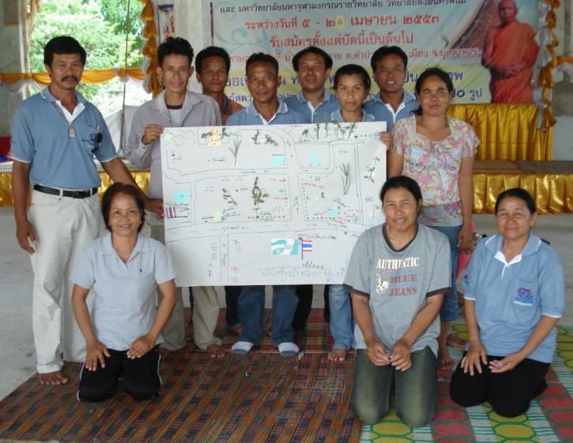
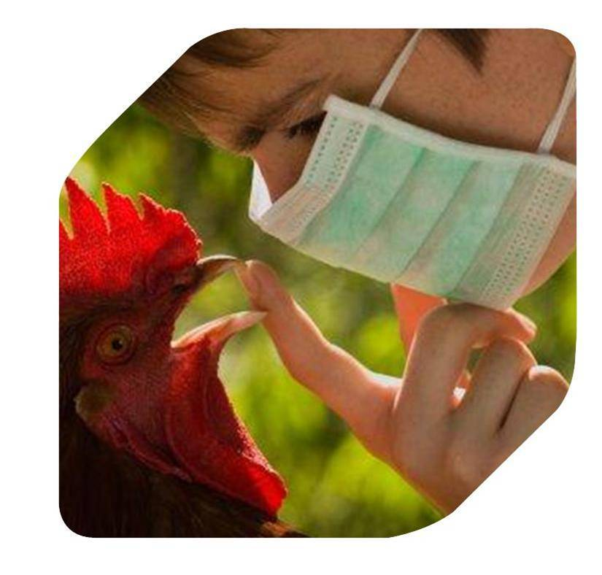
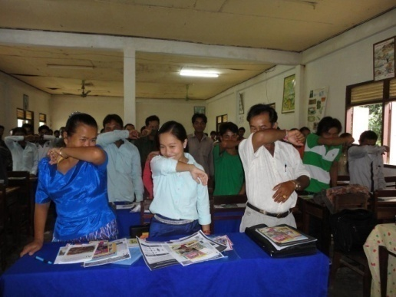
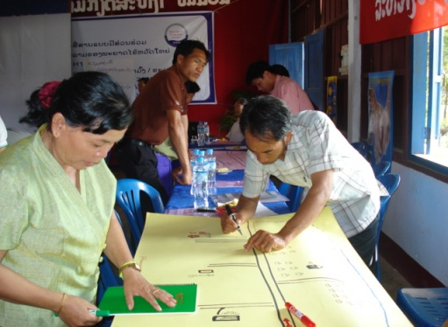
Empowering the “Front Line”
Provincial and District Animal Health (Veterinary) Officials
Field Epidemiologists
Health Care Workers
Village Authorities
Village Health Volunteers
Village Animal Health Volunteers (Paravets)
Community Leaders
Notes:
Continue working with health care workers, veterinarians and community leaders

Slide 15
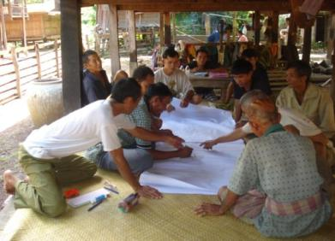
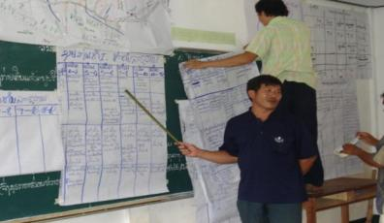
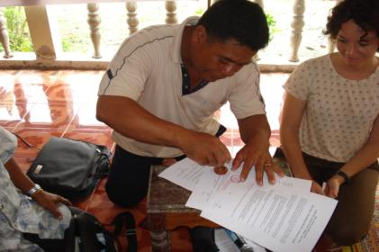
Empowering communities to protect themselves
One Village = One Poultry Unit
Participatory Approaches Work
Risk Assessment and Communication
Analysis of Resources and threats
Local Solutions
Notes:
Continue to seize the opportunity to work with the community to effectively conduct their own risk assessment, communicate and negotiate with each other, analyze disease threats, their own resources and develop local solutions that were often more effective and more feasible than the solutions proposed by the experts

Slide 16
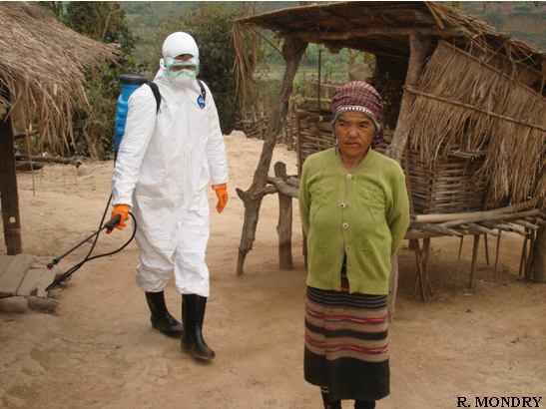
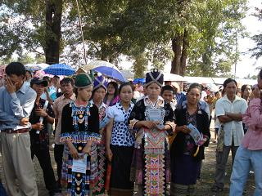
Bridging Language and Cultural Differences
Scientists and Farmers
Animal and Human Stakeholders
Ethnic minorities
Border communities
Notes:
PREVENT will consider cultural differences, language and ethnicity.

Slide 17
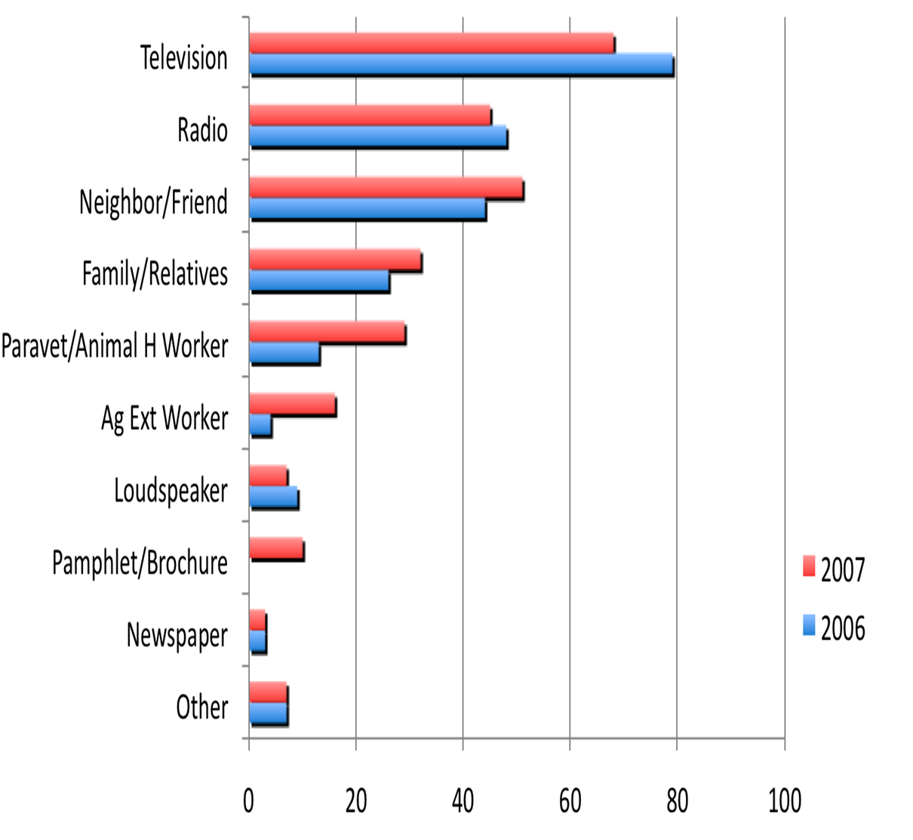
Supporting the media for accurate and responsible reporting to address fear and stigma

Slide 18
Where do we start?
Plan for Lao PDR
Identify “High-Risk" Groups at Animal-Human Interface
Primarily those most likely to be exposed and infected (e.g., hunters and others who come in contact with wild animals and their excreta, including urban populations)
But also institutions and organizations that create an enabling environment for transmission (e.g., wild animal/meat trade; extractive industries: logging, mining, oil)

Slide 19
Year 1-2: Potential activities
Plan for Lao PDR
Conduct exploratory research to identify high-risk populations and characterize risk factors
Identify ongoing interventions, assess effectiveness, feasibility of implementation at scale and sustainability
Notes:
Collecting information about the entire wild animal hunting-trade-consumption system within Lao PDR. The project would carry out studies of markets, restaurants and consumer demand for wild animal meat. Because bats are consumed in Lao PDR and they have been shown to harbor EPT viruses, the project proposes concentrating on markets in areas where bats are consumed in order to understand whether it might be possible to shift consumption to an animal that poses less risk, or develop and implement safer hunting/slaughtering/preparation practices for this meat source.
Exploring possibilities for interventions to reduce negative effects of extractive industry (hydropower, logging, and mining) on human-wildlife contact rates. A first step might be quantifying human-wildlife contact rates in areas near extractive industry sites. This is an important focus area, as Laos is undergoing a boom in extractive industries.

Slide 20
Year 3: Potential activities
Plan for Lao PDR
Implement tested interventions at scale
Support advocacy to build a supportive environment for EPT

Slide 21
Who do we work with?
Plan for Lao PDR
NEIDCO
NAFRI
WCS
National University
FAO
Notes:
To date, PREVENT has made a brief introductory visit to Lao PDR and initiated discussions with Wildlife Conservation Society (WCS, a partner in PREDICT). We anticipate that WCS will be a main PREVENT partner , NEIDCO and NAFRI (National Agriculture and Forestry Research Institute) and WCS as well as additional potential partners and stakeholders such as National University and FAO.

Slide 22
Thank you!

